Slide 1

CRITICAL DEATH REPORT DATASET
KIT DATA SCIENCE
Sheikh Alyan

Slide 2
WHY?
The CDR Report dataset contains a wide range of information related to critical incidents, including details about the incident, individuals involved, and circumstances leading to the incident. This rich and diverse data can provide valuable insights into the factors contributing to critical incidents and help improve safety protocols and procedures.

Slide 3
DATA CLEANING
Filling of Null values
Dropping of unwanted columns
Data redundancy
Changing Of Datatypes of column
Combining the Distributed column

Slide 4
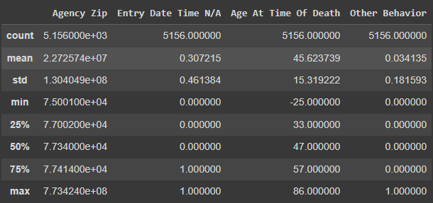
DATA DESCRIPTION

Slide 5
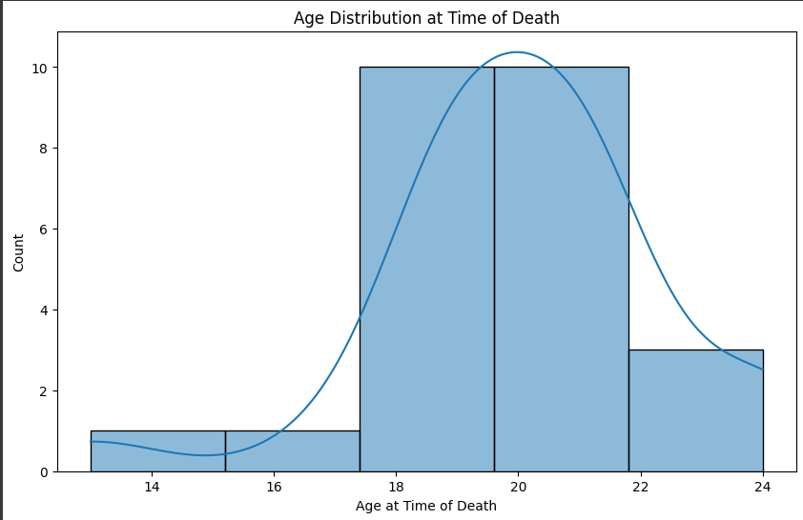
DATA VISUALISATION
Distribution Of Age with respect to Death

Slide 6
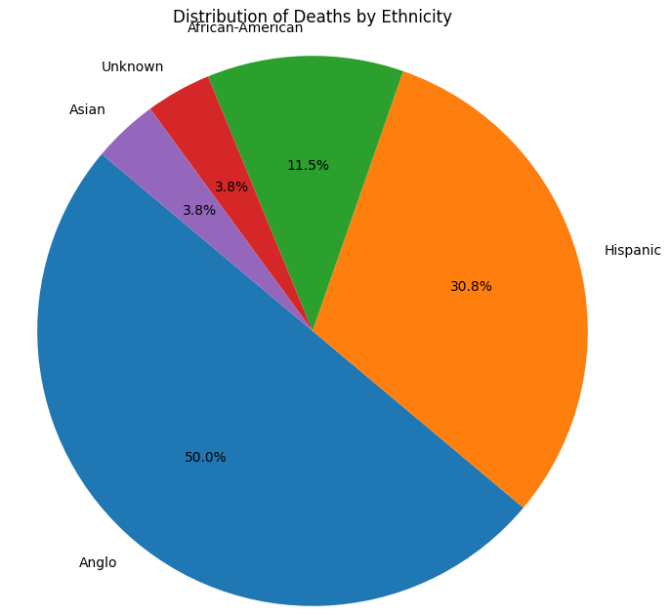
DATA VISUALISATION
Distribution Of Death by Ethnicity

Slide 7
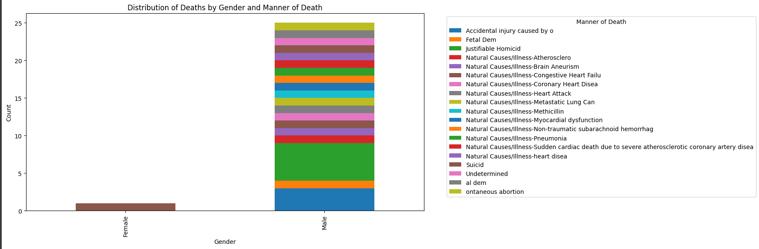
DATA VISUALISATION
Distribution Of Death by Gender and Manner of Death

Slide 8
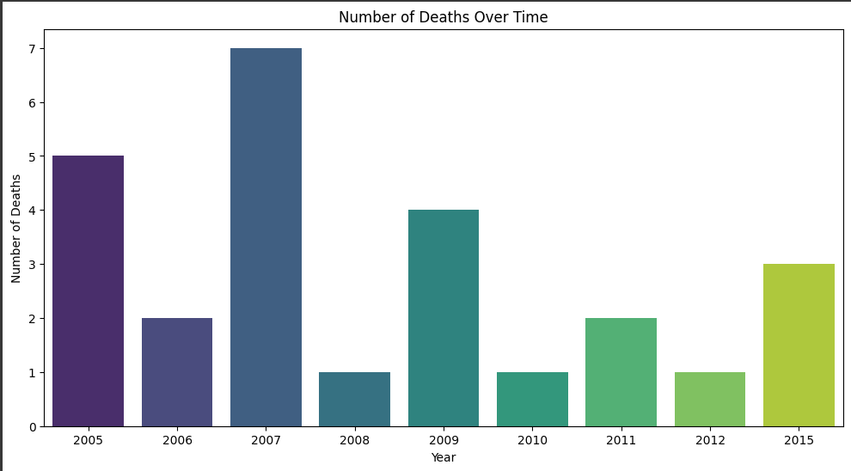
DATA VISUALISATION
Number Of Deaths Of Overtime

Slide 9
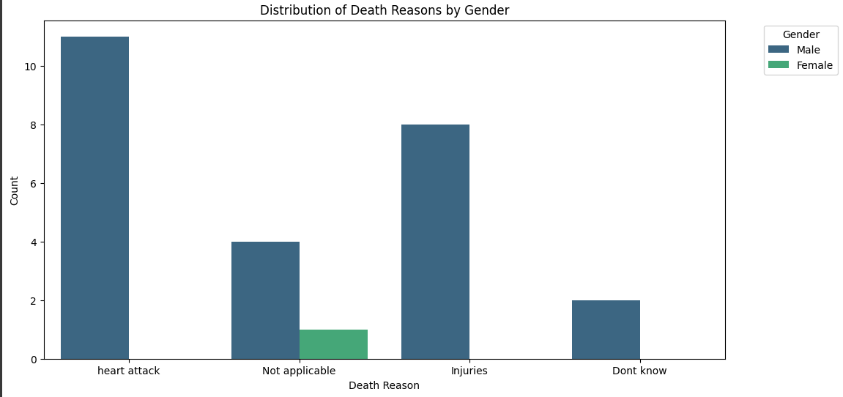
DATA VISUALISATION
Distribution of Death Reason By Gender

Slide 10
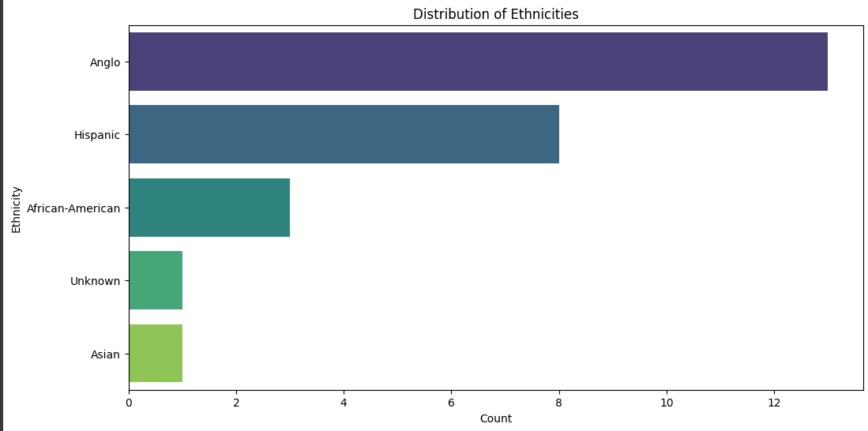
DATA VISUALISATION
Distribution of Ethnicities

Slide 11
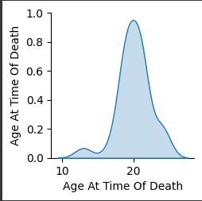
DATA VISUALISATION
Age at Time of Death

Slide 12
THANK YOU!

